Slide 1
Sales Dashboard Analysis – Power BI
Data Analyst Internship Task 4
Shreeya U Shetty
Tool used: Power BI

Slide 2
Objective
To design an interactive sales dashboard using Power BI
To analyze sales, profit, and order trends
To help business stakeholders make data-driven decisions

Slide 3
Dataset Used
Content:
Sample Superstore Dataset
Contains:
Sales
Profit
Orders
Category
Region
Order Date
Customer Segment

Slide 4
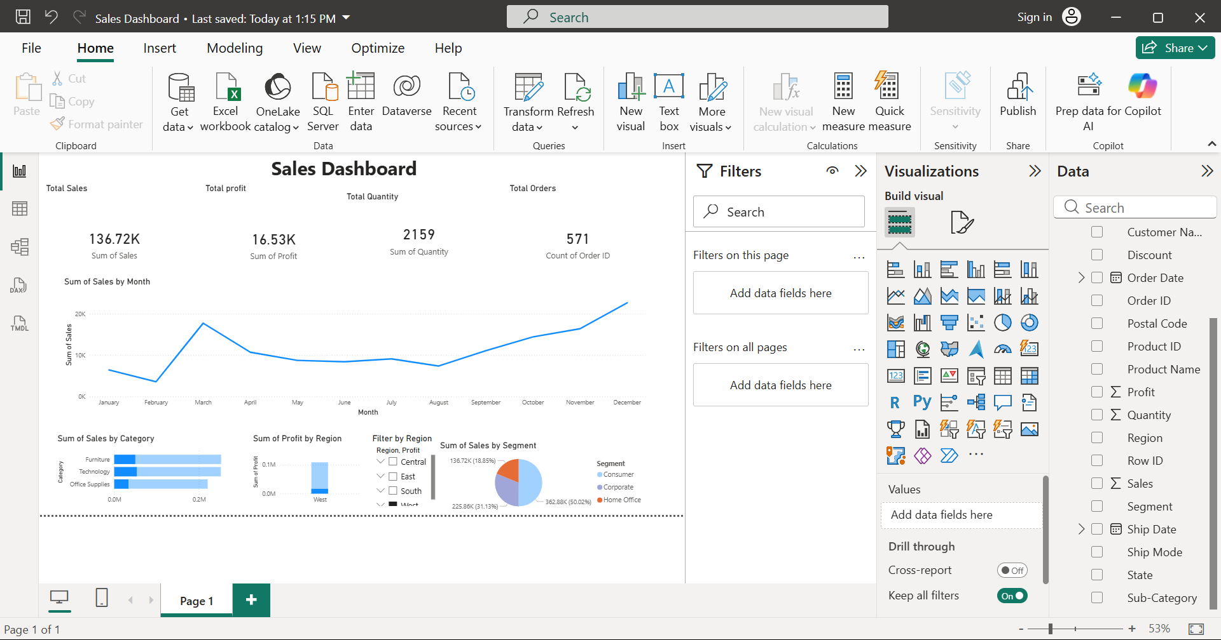
Dashboard Overview
KPI cards show total sales, profit, orders, quantity
Line chart shows sales trend over time
Bar chart shows sales by category
Pie chart shows sales by region
Slicer allows filtering by region

Slide 5
Key Insights
Technology category has highest sales
West region generates highest profit
Sales increased over time
Office supplies has highest quantity sold

Slide 6
Conclusion
Dashboard helps monitor business performance
Interactive filters improve analysis
Useful for business decision making

